Slide 1
Customer
Support Ticket Analysis with Sentence Embeddings
Presented by Group 4: Sirisha Jalamana, Sahil Raj, Rohith , Raghu
Guide: Ms. Apeksha Rahangdale

Slide 2

Assignment 1: Embeddings Experiment Overview
This experiment focused on using sentence embeddings to analyze and categorize customer support tickets from the Tobi-Bueck/customer- support-tickets dataset.
Data Collection
Gathered 1,000 customer support tickets
from the Hugging Face dataset.
Tagging & Categorization
Classified tickets into High, Medium, and
Low priority using keyword-based rules.
Embedding Generation
Used the free model
all-MiniLM-L6-v2
(Sentence Transformers) to generate
numerical sentence embeddings.

Slide 3


Methodology: From Text to Numerical Vectors
The core objective was to automatically categorize tickets and generate meaningful numerical representations using an AI model.
Data Loading
Loaded 1,000 tickets from the source dataset.
Priority Tagging
Developed a rule-based system using keywords (e.g., "urgent" →
High, "question" → Low) to assign priority.
Embedding Generation
Applied the
all-MiniLM-L6-v2
model to convert ticket text into
high-dimensional numerical vectors.

Slide 4
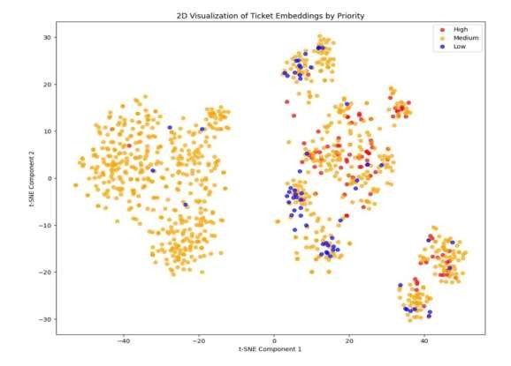
Results & Visualization: Semantic Clustering
Key Observations
The visualization confirms that the sentence embeddings successfully captured the semantic meaning and urgency of the tickets.
The model grouped semantically similar tickets into distinct clusters.
High-priority tickets (represented by red dots) are tightly clustered together, indicating common urgent language.
Embeddings effectively capture the underlying meaning and urgency of unstructured text.

Slide 5
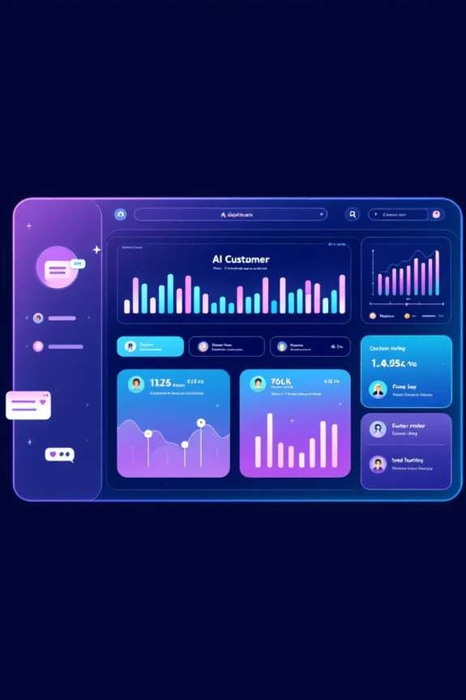
Conclusion & Future Applications
Sentence embeddings are highly effective for understanding unstructured text like customer support messages, paving the way for automated efficiency.
Automatic Routing
Direct tickets to the appropriate department instantly based on content.
Predictive Classification
Instantly predict the priority (High, Medium, Low) of new incoming tickets.
Duplicate Detection
Identify and merge similar or redundant tickets for operational efficiency.

